Slide 1
What this lecture is about?
1. Become familiar with position weight matrices (PWMs)
2. Learn how to calculate PWMs based on sequence data

Slide 2
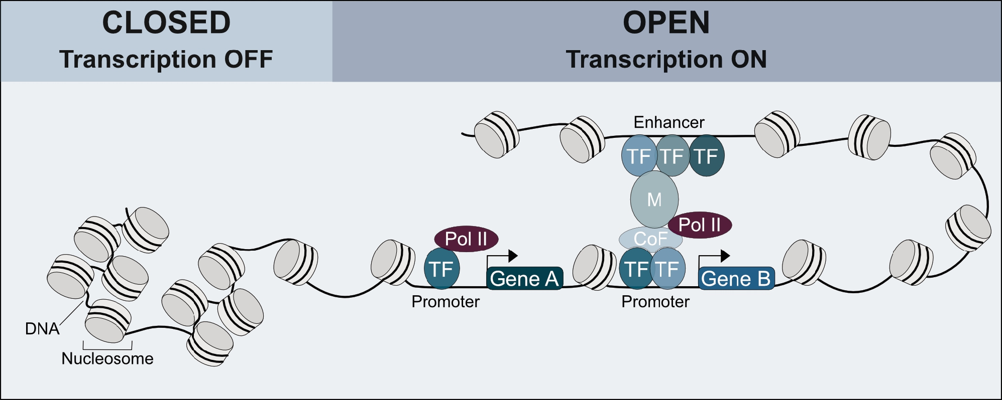
Transcription factors
Leiz et al. Medizinische Genetik, 2021.

Slide 3
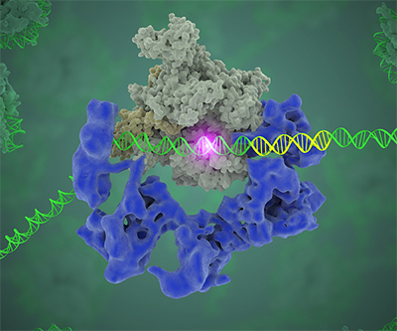
Transcription factor binding affinity
1. The covered area might be large
2. The recognition motif might be narrow
https://www.nichd.nih.gov/about/org/dir/dir_showcase/clark-transcription-factor-binding-sites

Slide 4
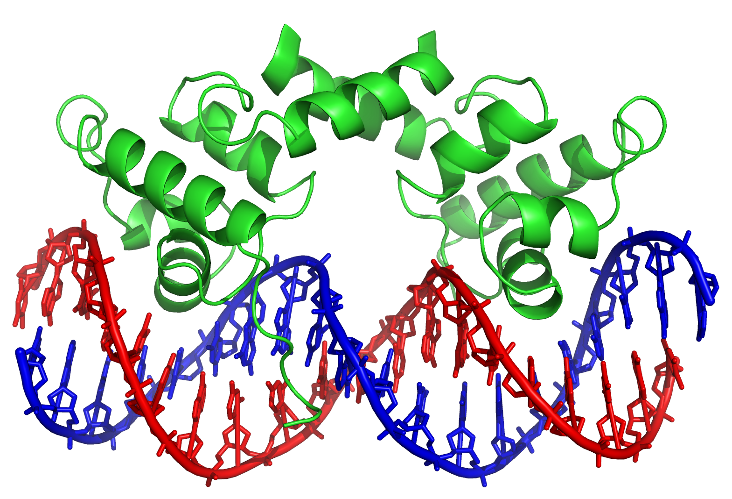
Transcription factor binding affinity
How can we identify TF recognition motifs?

Slide 5
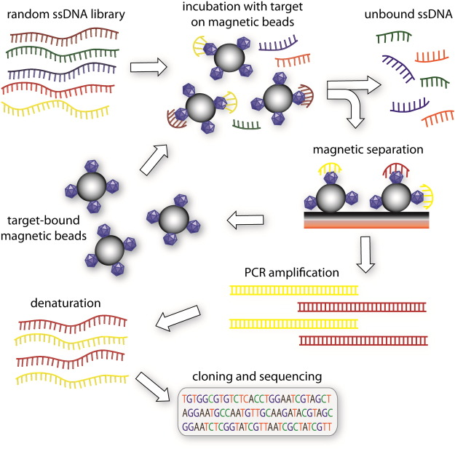
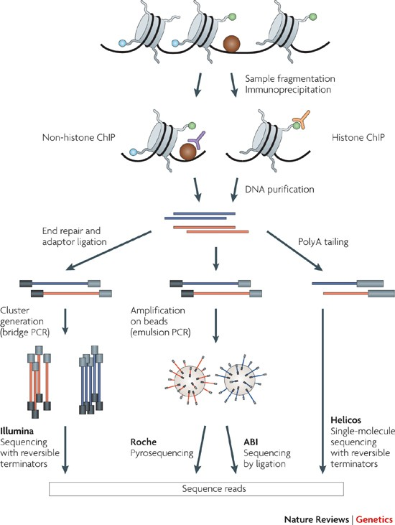
Identifying transcription factor binding affinities
SELEX-Seq
ChIP-Seq
Darmostuk et al. Biotechnology Advances, 2015.
Park. Nature Reviews Genetics, 2009.

Slide 6
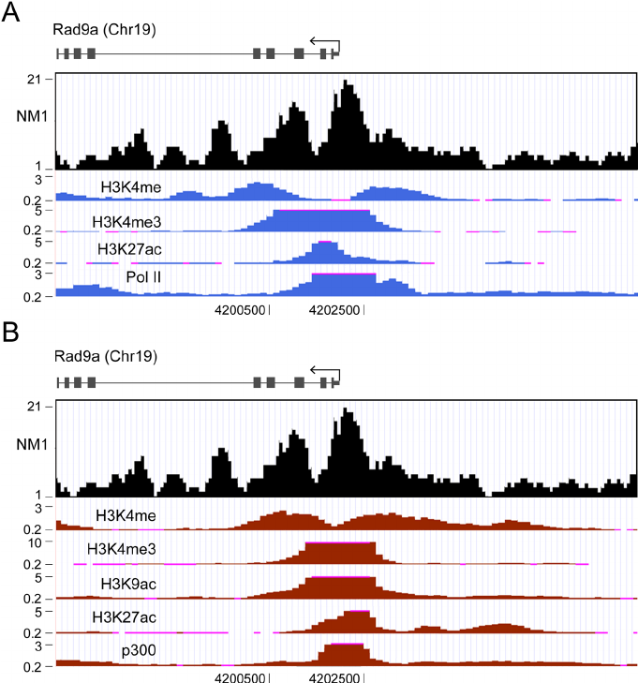
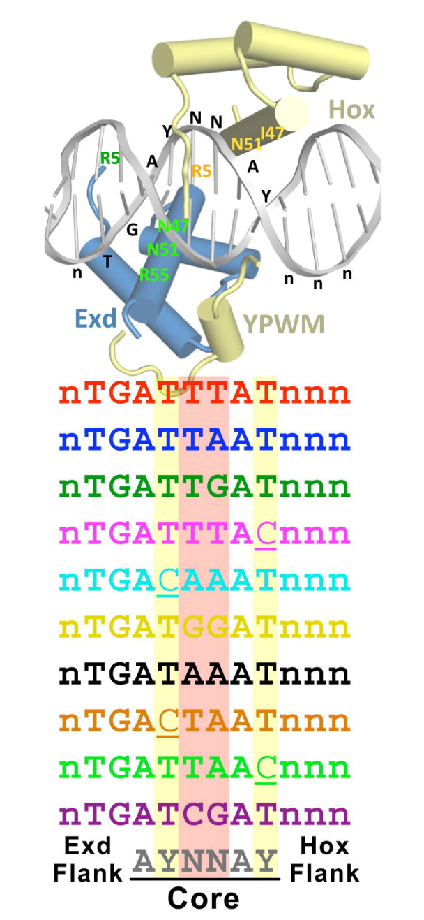
SELEX-Seq vs ChIP-Seq
SELEX-Seq
ChIP-Seq
Slatery et al. Cell, 2011.
Almuzzaini et al. BMC Biology, 2015.

Slide 7
SELEX-Seq vs ChIP-Seq
SELEX-Seq
ChIP-Seq
1. What’s the difference between the two approaches?
2. In this lecture we will focus on SELEX-Seq
Slatery et al. Cell, 2011.
Almuzzaini et al. BMC Biology, 2015.

Slide 8
From SELEX-Seq data to position frequency matrices (PFMs)
SELEX-Seq data on GATA3
AGATAG
AGATAG
AGATAG
AGATAG
CGATAG
AGATAC
AGATAA
GGATAC
CGATTG
CGATTG
AGATAG
AGAGAG
CGATAC
AGATTG
CGATAG
AGATAC
AGATAA
GGATAC
CGATTG
CGATTG

Slide 9
From SELEX-Seq data to position frequency matrices (PFMs)
SELEX-Seq data on GATA3
AGATAG
AGATAG
AGATAG
AGATAG
CGATAG
AGATAC
AGATAA
GGATAC
CGATTG
CGATTG
AGATAG
AGAGAG
CGATAC
AGATTG
CGATAG
AGATAC
AGATAA
GGATAC
CGATTG
CGATTG
Nucleotide/ Position | 1 | 2 | 3 | 4 | 5 | 6
A | 11 | 0 | 20 | 0 | 15 | 2
T | 0 | 0 | 0 | 19 | 5 | 0
G | 2 | 20 | 0 | 1 | 0 | 13
C | 7 | 0 | 0 | 0 | 0 | 5
…
. . .

Slide 10

From PFMs to position probability matrices (PPMs)
Nucleotide/ Position | 1 | 2 | 3 | 4 | 5 | 6
A | 11 | 0 | 20 | 0 | 15 | 2
T | 0 | 0 | 0 | 19 | 5 | 0
G | 2 | 20 | 0 | 1 | 0 | 13
C | 7 | 0 | 0 | 0 | 0 | 5
Nucleotide/ Position | 1 | 2 | 3 | 4 | 5 | 6
A | 0.55 | 0 | 1 | 0 | 0.75 | 0.1
T | 0 | 0 | 0 | 0.95 | 0.25 | 0
G | 0.1 | 1 | 0 | 0.05 | 0 | 0.65
C | 0.35 | 0 | 0 | 0 | 0 | 0.25

Slide 11
Using PPMs to calculate the probability of binding
Nucleotide/ Position | 1 | 2 | 3 | 4 | 5 | 6
A | 0.55 | 0 | 1 | 0 | 0.75 | 0.1
T | 0 | 0 | 0 | 0.95 | 0.25 | 0
G | 0.1 | 1 | 0 | 0.05 | 0 | 0.65
C | 0.35 | 0 | 0 | 0 | 0 | 0.25
Target sequence:
TGATAGACGATCAGTC

Slide 12
Using PPMs to calculate the probability of binding
Nucleotide/ Position | 1 | 2 | 3 | 4 | 5 | 6
A | 0.55 | 0 | 1 | 0 | 0.75 | 0.1
T | 0 | 0 | 0 | 0.95 | 0.25 | 0
G | 0.1 | 1 | 0 | 0.05 | 0 | 0.65
C | 0.35 | 0 | 0 | 0 | 0 | 0.25
T
G
A
T
A
G
Target sequence:
TGATAGACGATCAGTC

Slide 13
Using PPMs to calculate the probability of binding
Nucleotide/ Position | 1 | 2 | 3 | 4 | 5 | 6
A | 0.55 | 0 | 1 | 0 | 0.75 | 0.1
T | 0 | 0 | 0 | 0.95 | 0.25 | 0
G | 0.1 | 1 | 0 | 0.05 | 0 | 0.65
C | 0.35 | 0 | 0 | 0 | 0 | 0.25
T
G
A
T
A
G
Target sequence:
TGATAGACGATCAGTC
0
1
1
0.95
0.75
0.65

Slide 14
Using PPMs to calculate the probability of binding
Nucleotide/ Position | 1 | 2 | 3 | 4 | 5 | 6
A | 0.55 | 0 | 1 | 0 | 0.75 | 0.1
T | 0 | 0 | 0 | 0.95 | 0.25 | 0
G | 0.1 | 1 | 0 | 0.05 | 0 | 0.65
C | 0.35 | 0 | 0 | 0 | 0 | 0.25
T
G
A
T
A
G
Target sequence:
TGATAGACGATCAGTC
0
x
1
x
1
x
0.95
x
0.75
x
0.65
=
0.0

Slide 15
Adding pseudocounts before the calculation of PPMs
Nucleotide/ Position | 1 | 2 | 3 | 4 | 5 | 6
A | (11) 12 | (0) 1 | (20) 21 | (0) 1 | (15) 16 | (2) 3
T | (0) 1 | (0) 1 | (0) 1 | (19) 20 | (5) 6 | (0) 1
G | (2) 3 | (20) 21 | (0) 1 | (1) 2 | (0) 1 | (13) 14
C | (7) 8 | (0) 1 | (0) 1 | (0) 1 | (0) 1 | (5) 6
Nucleotide/ Position | 1 | 2 | 3 | 4 | 5 | 6
A | 0.5 | 0.041 | 0.875 | 0.041 | 0.66 | 0.125
T | 0.041 | 0.041 | 0.041 | 0.83 | 0.25 | 0.041
G | 0.125 | 0.875 | 0.041 | 0.083 | 0.041 | 0.58
C | 0.33 | 0.041 | 0.041 | 0.041 | 0.041 | 0.25

Slide 16
Using PPMs to calculate the probability of binding
Nucleotide/ Position | 1 | 2 | 3 | 4 | 5 | 6
A | 0.5 | 0.041 | 0.875 | 0.041 | 0.66 | 0.125
T | 0.041 | 0.041 | 0.041 | 0.83 | 0.25 | 0.041
G | 0.125 | 0.875 | 0.041 | 0.083 | 0.041 | 0.58
C | 0.33 | 0.041 | 0.041 | 0.041 | 0.041 | 0.25
T
G
A
T
A
G
Target sequence:
TGATAGACGATCAGTC
0.041
x
0.875
x
0.875
x
0.83
x
0.66
x
0.58
=
0.00997

Slide 17

From PPMs to position weight matrices (PWMs)
Nucleotide/ Position | 1 | 2 | 3 | 4 | 5 | 6
A | 0.5 | 0.041 | 0.875 | 0.041 | 0.66 | 0.125
T | 0.041 | 0.041 | 0.041 | 0.83 | 0.25 | 0.041
G | 0.125 | 0.875 | 0.041 | 0.083 | 0.041 | 0.58
C | 0.33 | 0.041 | 0.041 | 0.041 | 0.041 | 0.25
Nucleotide/ Position | 1 | 2 | 3 | 4 | 5 | 6
A | 1 | -2.6 | 1.8 | -2.6 | 1.4 | -1
T | -2.6 | -2.6 | -2.6 | 1.8 | 0 | -2.6
G | -1 | 1.8 | -2.6 | -1.59 | -2.6 | 1.2
C | 0.4 | -2.6 | -2.6 | -2.6 | -2.6 | 0

Slide 18
Using PWMs to calculate the binding score
Nucleotide/ Position | 1 | 2 | 3 | 4 | 5 | 6
A | 1 | -2.6 | 1.8 | -2.6 | 1.4 | -1
T | -2.6 | -2.6 | -2.6 | 1.8 | 0 | -2.6
G | -1 | 1.8 | -2.6 | -1.59 | -2.6 | 1.2
C | 0.4 | -2.6 | -2.6 | -2.6 | -2.6 | 0
T
G
A
T
A
G
Target sequence:
TGATAGACGATCAGTC
-2.6
+
1.8
+
1.8
+
1.8
+
1.4
+
1.2
=
5.4

